Slide 1
CSE 2215: Data Structure and Algorithms-I
Time Complexity Part 2
Master Theorem
Equations and asymptotic notations
Using Recursion and Substitution for Solving Time Complexities

Slide 2
MASTER THEOREM

Slide 3
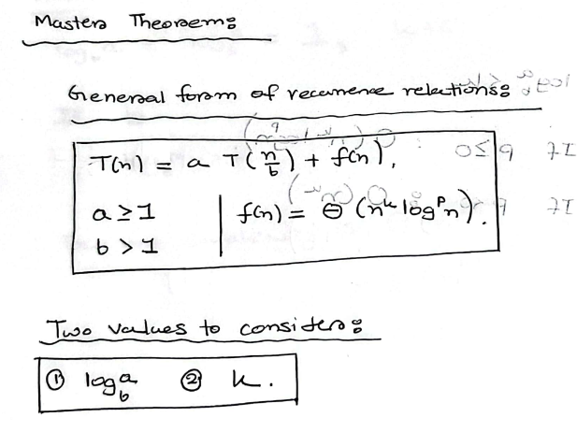
Master Theorem

Slide 4
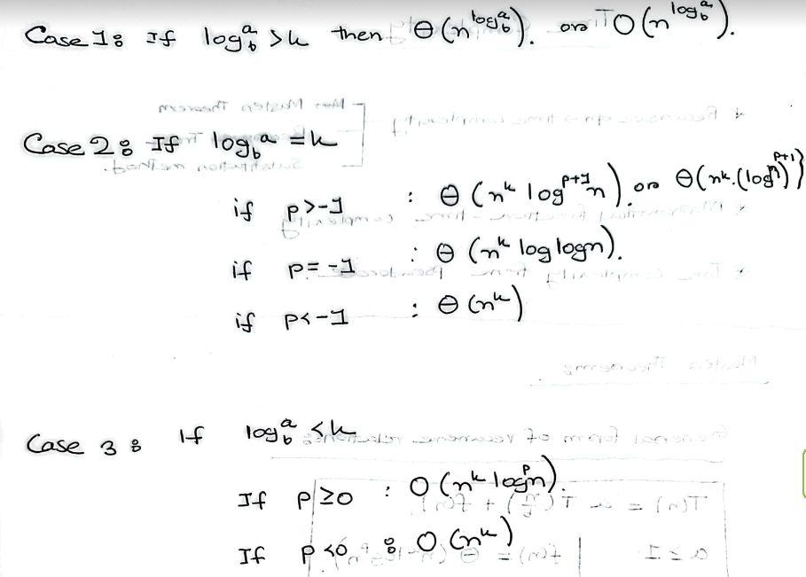
Master Theorem

Slide 5
Master Theorem
Click here for the note containing the solved examples.

Slide 6
EQUATIONS AND ASYMPTOTIC NOTATIONS

Slide 7
SOLVING RECURRENCES FOR TIME COMPLEXITY

Slide 8
Equations and Asymptotic Notations
This was covered in DSA I
However for revision you may look up the following document

Slide 9
Solving Recurrences for Time complexity
Let us consider the following recurrence relations as examples
T(n)=3T(n/2)+n
T(n)=2T(n/3)+O(n)
T(n)=3T(n/6)+O(n)
T(n)=T(n-1)+n
T(n)= 4T(n/3)+n²
Note: We can apply the Master’s Theorem in order to precheck the answer

Slide 10
Thank You

